Slide 1


Analyzing the relationship between rodent sightings and inspections in New York
GW DATA ANALYSIS PROJECT 1
Kwadwo Frimpong,
Kathleen Buckingham,
Irby Hunter
Ganesh Persaud

Slide 2

Are rodent sightings and rodent inspections in New York correlated?
Hypothesis: Rodent sighting are correlated with rodent inspections
This relationship will be shown by: More sightings leads to more inspections
Null hypothesis: There is no relationship between rodent sightings and rodent inspections

Slide 3
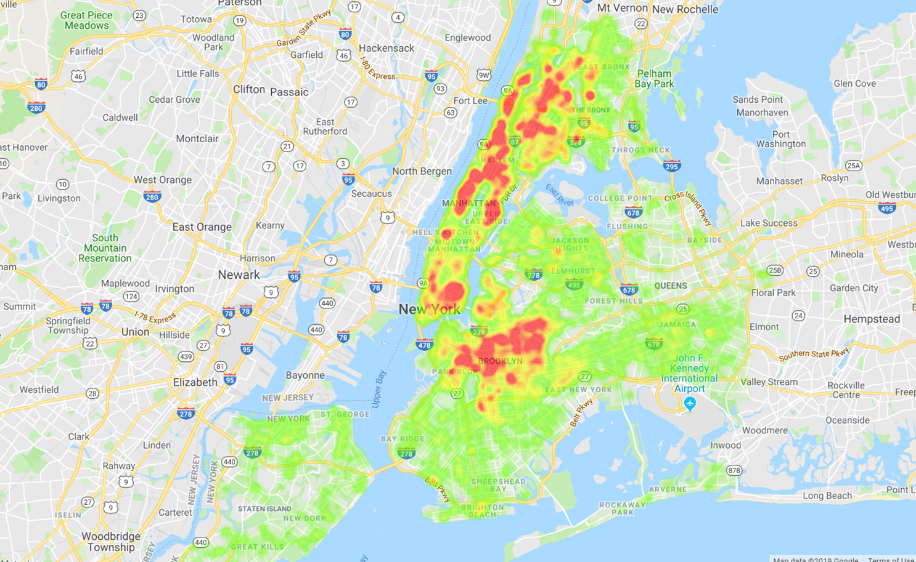
What was the data cleaning process?
Four CSV datasets from Kaggle:
NYC Rat Sightings (~102k Observations)
NY Rodent Inspection (~900k Observations)
NYC Restaurant Inspections (~400K inspections)
US Income Census Data (~30k observations)
Filtered by:
Year: 2012- 2016
Location: Latitude and Longitude
Borough
Zip Code
Violation code
Cuisine type
Income

Slide 4
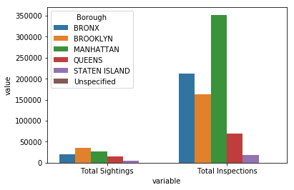
Total rat sightings and inspections per borough

Slide 5
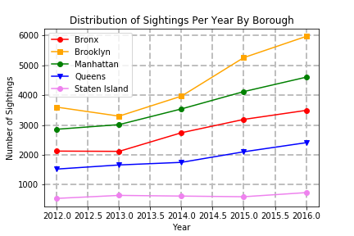

Slide 6
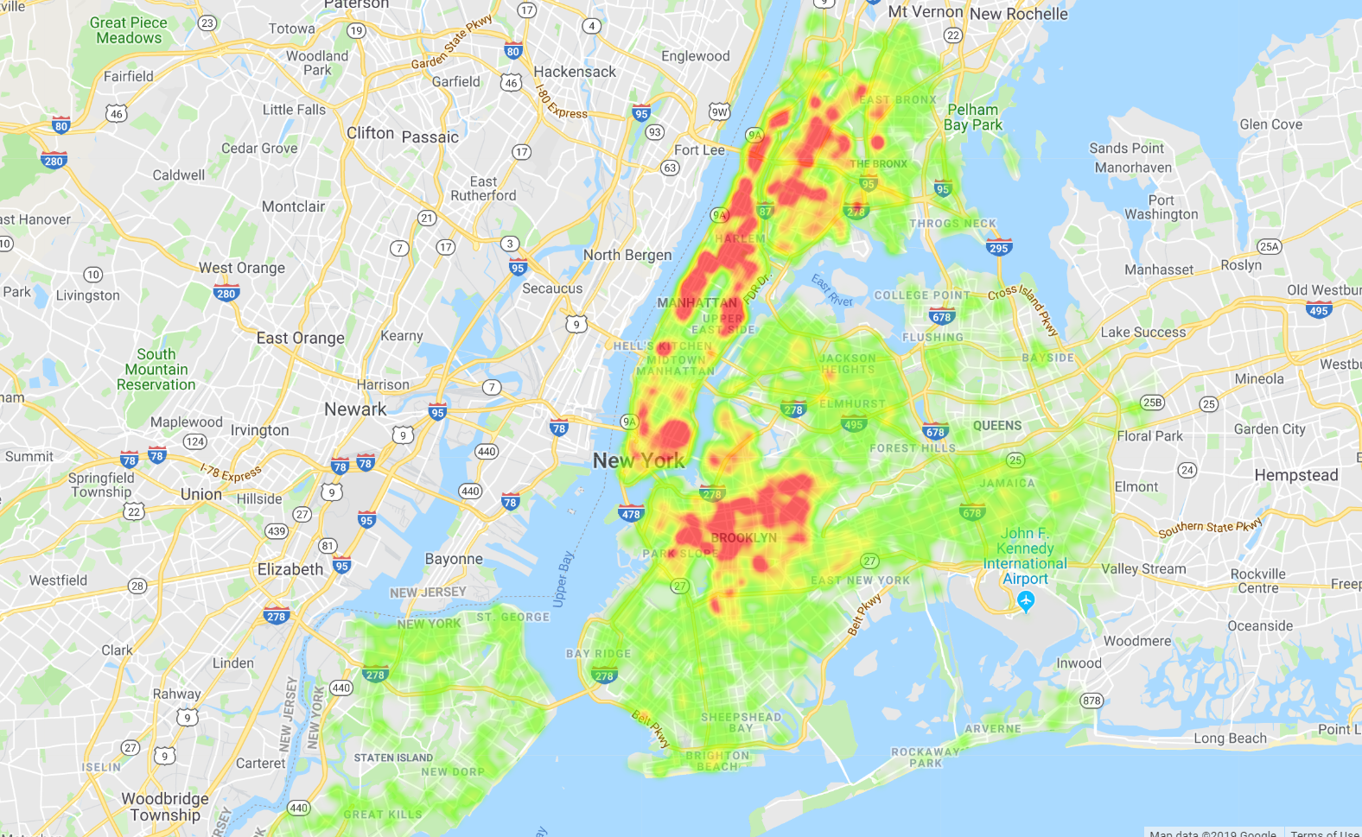
Rodent sightings in New York

Slide 7
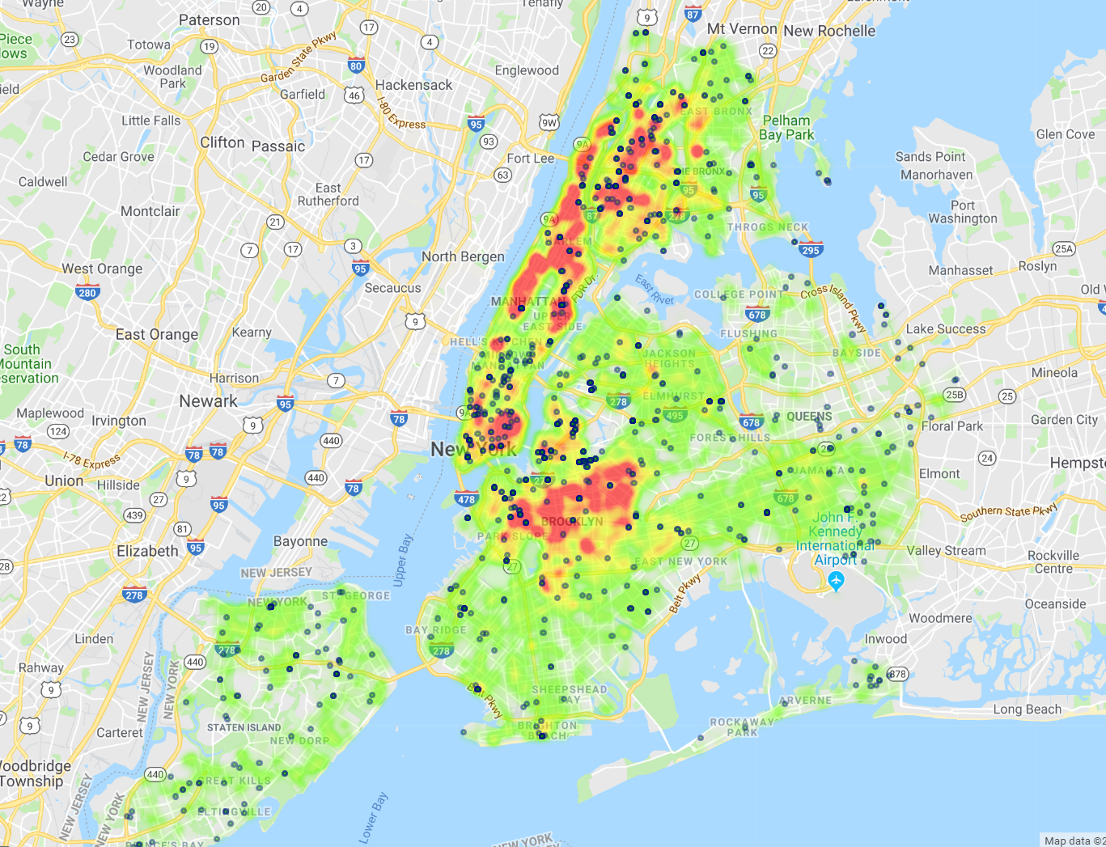
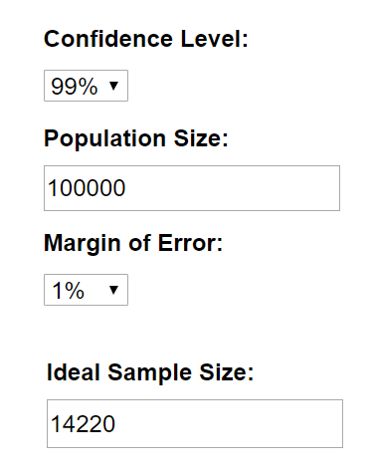
Rodent sightings and rodent inspections in
New York
Random Sample

Slide 8
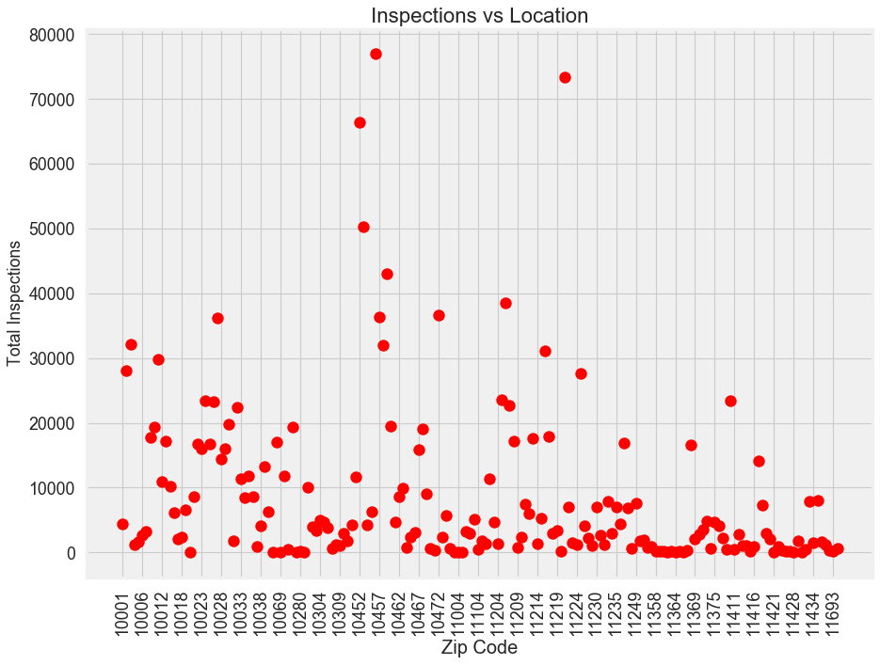

Slide 9
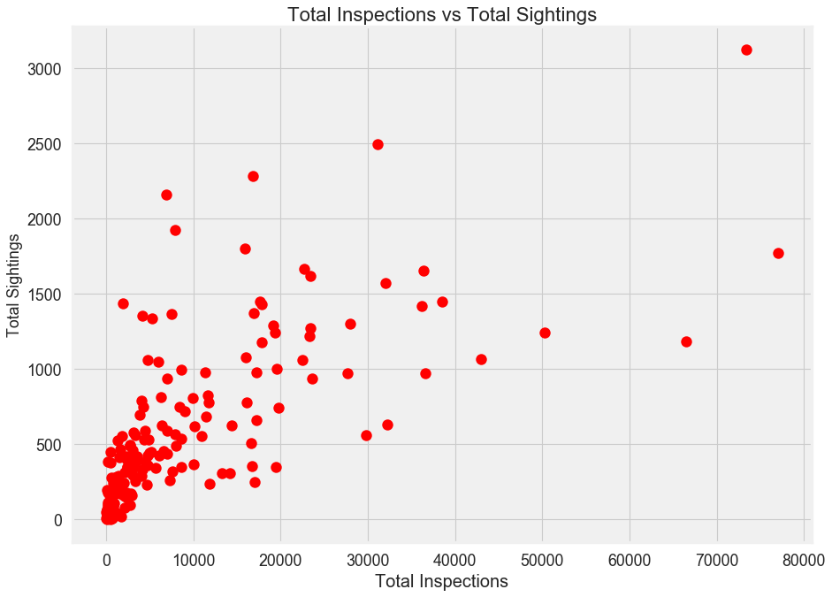

Slide 10
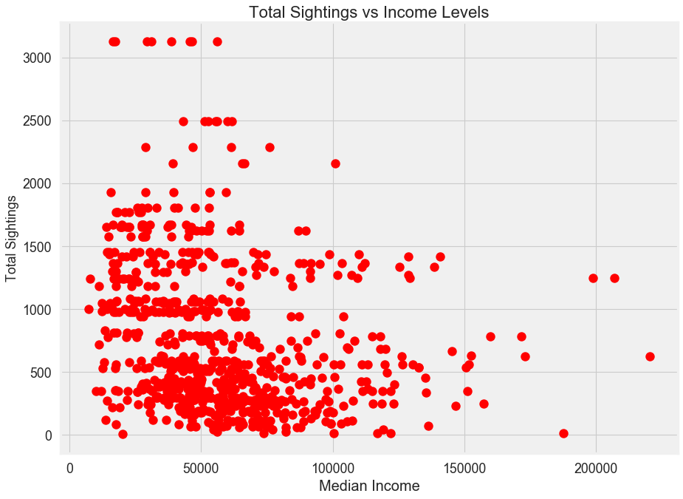

Slide 11

Statistical Analysis
Question 1: Are Total Sightings & Total Inspections related?
Method: Correlation test (Spearman rank)
Findings: Significant relationship
(81% correlation)
Question 2: Are Rat Sightings & Socioeconomic status related?
Method: Correlation test (Spearman rank)
Findings: Weak relationship
(32% correlation)

Slide 12
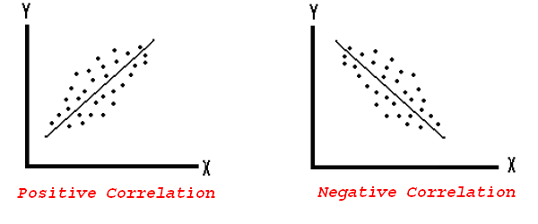
Positive and Negative Correlation

Slide 13
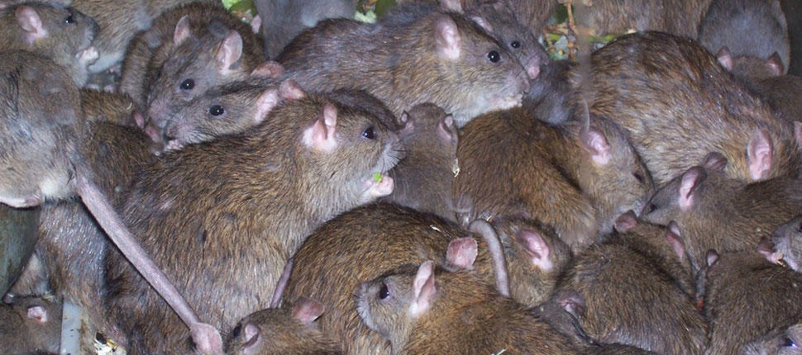
Some Observations
There are areas with higher and lower density of rat sightings in New York
Brooklyn has the most sightings and Staten Island the least
Manhattan has the most inspections. Manhattan was the borough with the second highest sightings
Some questions remain unanswered:
Why have sightings of rats increased?
Other variables may be important. These include:
Health standard requirements: When opening a new catering business are there inspection standards that need to be met?

Slide 14
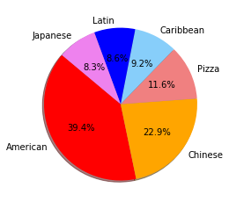
Cuisine type & rodent violations
Filtered violation code: 04L: Live mice in food or mice in environment
Where are the locations of these restaurants?
What is the price points of these restaurants?
Is there a correlation between price and violations?

Slide 15
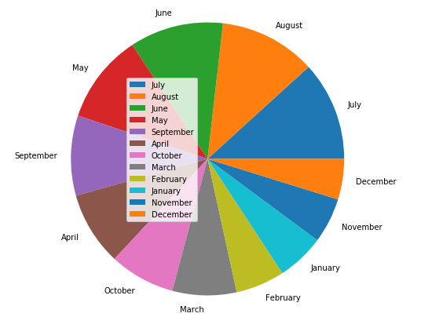
Sightings per month (all years)
Are there certain months with more sightings?
Is there a correlation between rat mating season/s (population) and sightings?

Slide 16
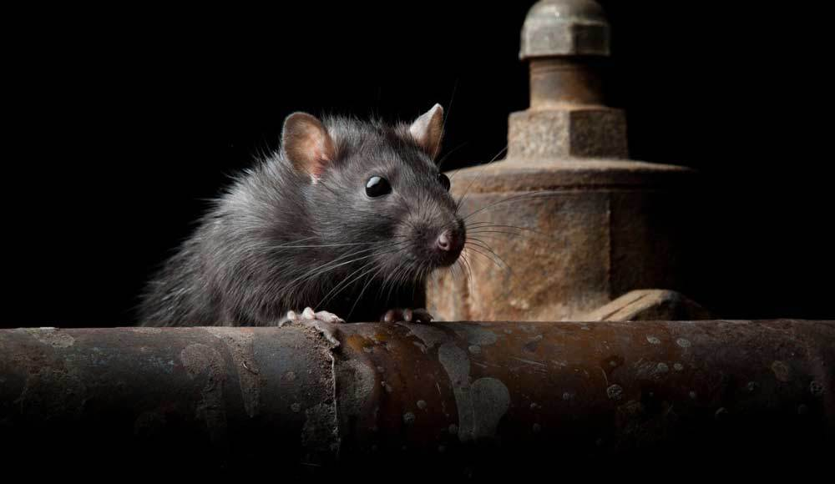
Thanks from the data rats!

